Slide 1
DS1 Project
Clayton McCray, Juan Carlos Mier, Elvis Carter, Vince Vu

Slide 2
Image Segmentation Dataset
The data set being modeled pertains to image segmentation.
Image segmentation is the process of partitioning an image into distinct segments.
This allows you to group the objects in an image into a respective group.
The models used in our research include Neural Network, Support Vector Machine, Decision Tree, and Kth Nearest Neighbors

Slide 3

Support Vector Machine
First obstacle: select a kernel
This was mostly trial and error since the data set was not too large
Went with the Radial Basis Function
No dimensional limit; data set had 19 attributes
Defines similarity as

Slide 4
Hyperparameters
Radial Basis Function kernel requires two hyperparameters
ℽ (gamma) can be seen in the definition of the kernel. Smaller gamma means points must be closer together to be considered similar
C is a measure of penalization when training samples are misclassified
Selected:
gamma=1e-05
C=1e+05

Slide 5
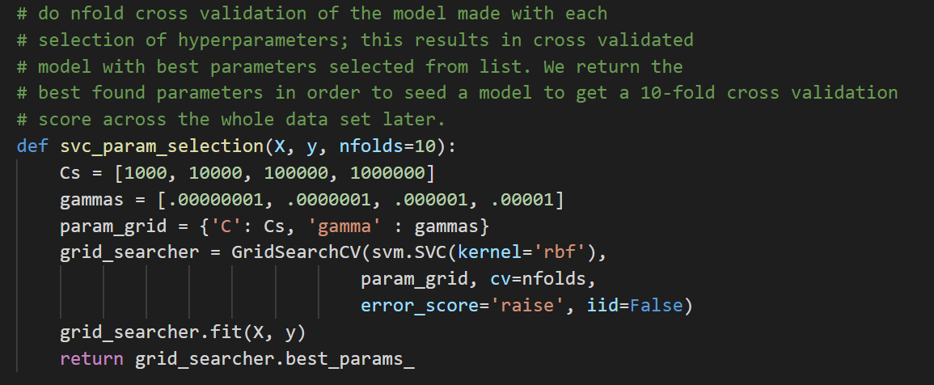
Selecting hyperparameters

Slide 6
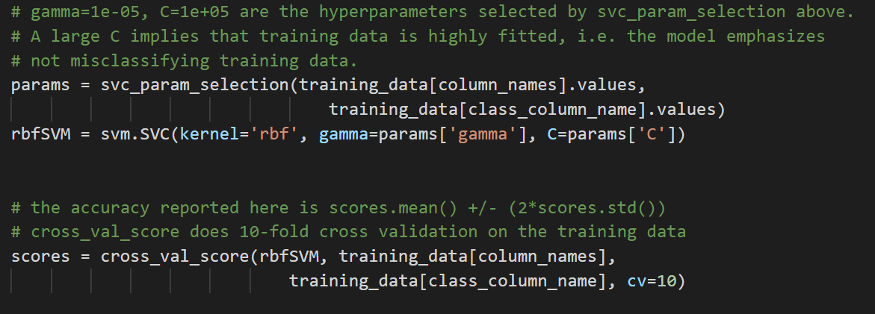
Accuracy: .97 (+/- .04)

Slide 7
Legend for Graphs
0 : BRICKFACE
1 : CEMENT
2 : FOLIAGE
3: GRASS
4 : PATH
5 : SKY
6 : WINDOW

Slide 8
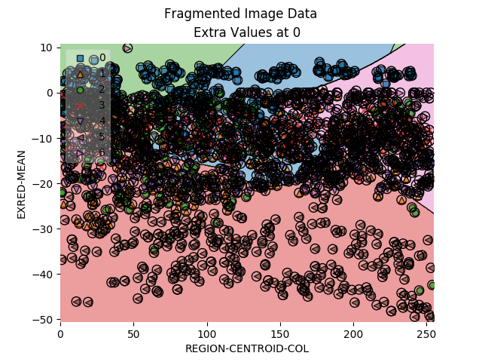

Slide 9
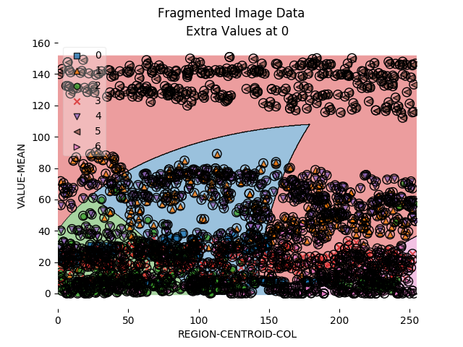

Slide 10
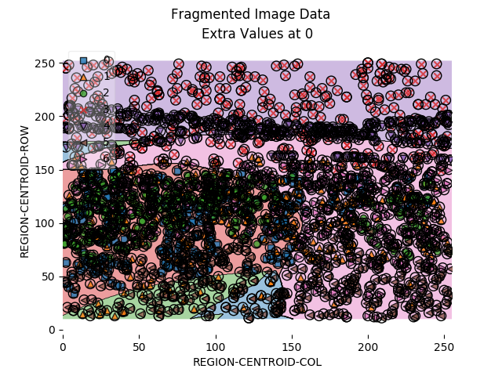

Slide 11
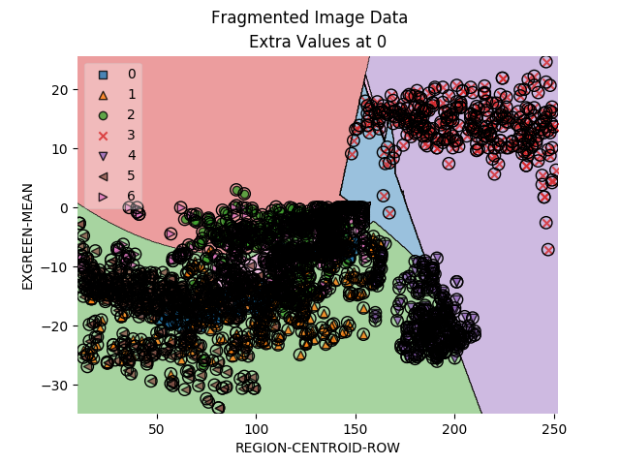

Slide 12
Neural Network
Juan Carlos Mier

Slide 13
Neural Network
Designing the architecture of the model
19 input attributes
7 output classes
1 hidden layer
Arbitrary assignment
Tanh and Logarithmic activation function
Room for optimization
10 fold cross validation

Slide 14
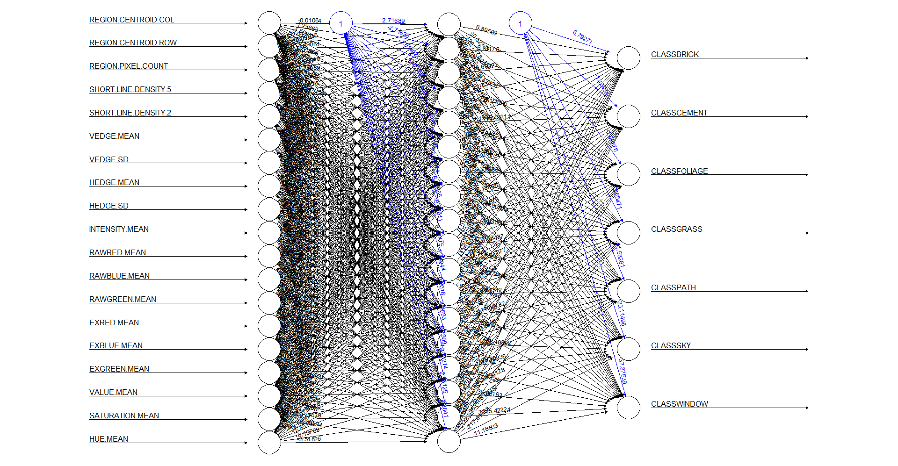
Validation Accuracy of 62%

Slide 15
Validation Accuracy of 70%

Slide 16
Decision Tree
Decision trees start from the top node which is known as the root node.
The tree traverses downward and interprets the data at each branch making sure it satisfies a specific condition.
The most important predictors are located towards the top of the tree.
When all conditions are satisfied, the tree must arrive at a terminal node.
This signals the end of the tree.
The resulting terminal node is the final output/decision.

Slide 17
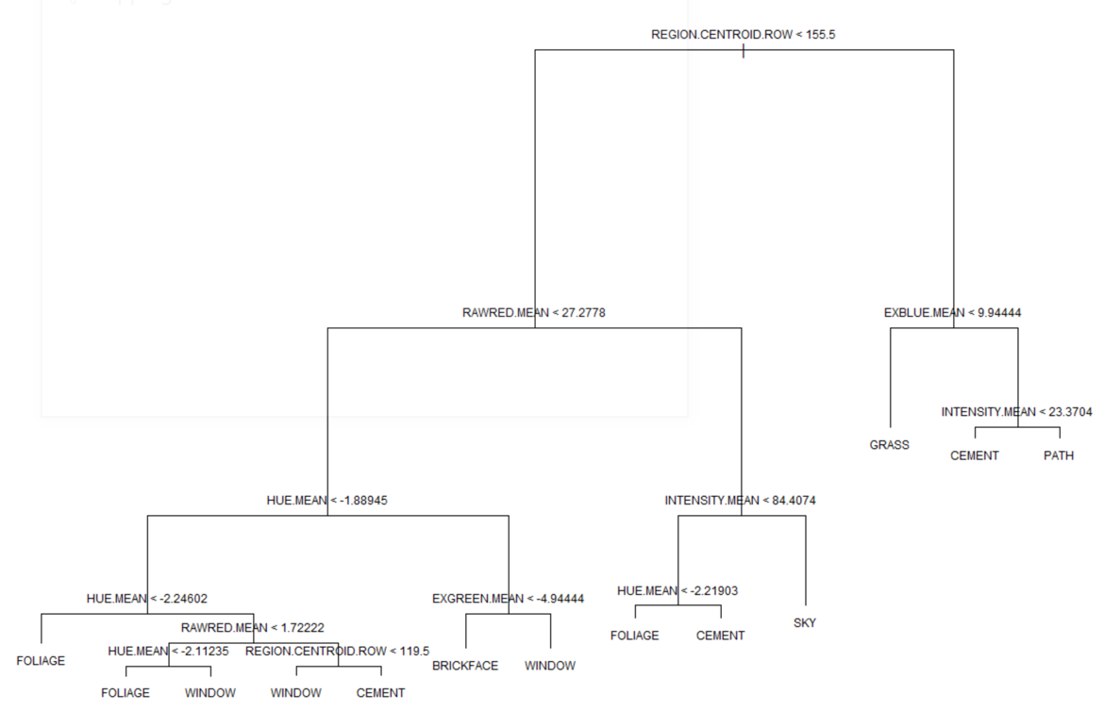

Slide 18
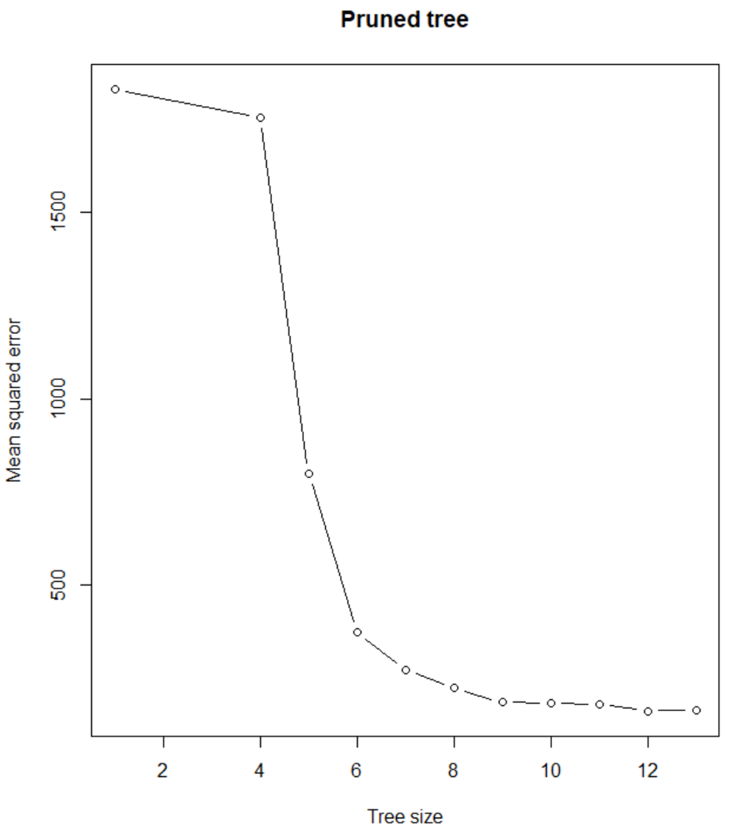

Slide 19
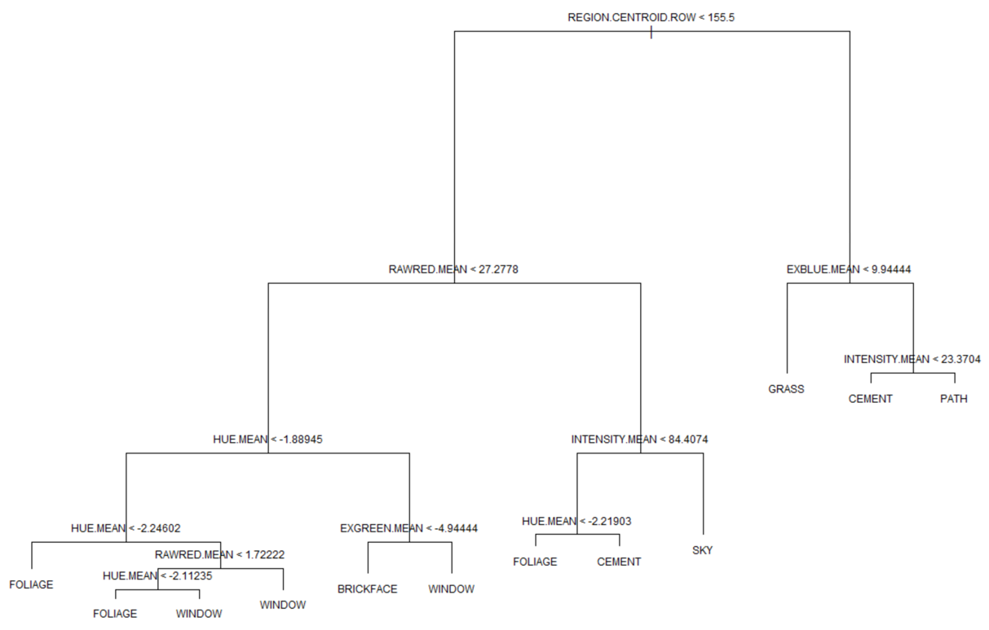

Slide 20
K-Nearest Neighbors
The KNN algorithm assumes that similar data objects exist in a close proximity with one another.
A distance function is created to calculate the distances between the data points.
Initialize K to the chosen number of neighbors.
Calculate the distances from the query point to each neighbor.
Sort the query distances from smallest to largest in terms of distance.
Choose the first K entries from the sorted vector.
Run the algorithm multiple times with different values for K until the number of errors is low enough to allow for an accurate prediction.

Slide 21
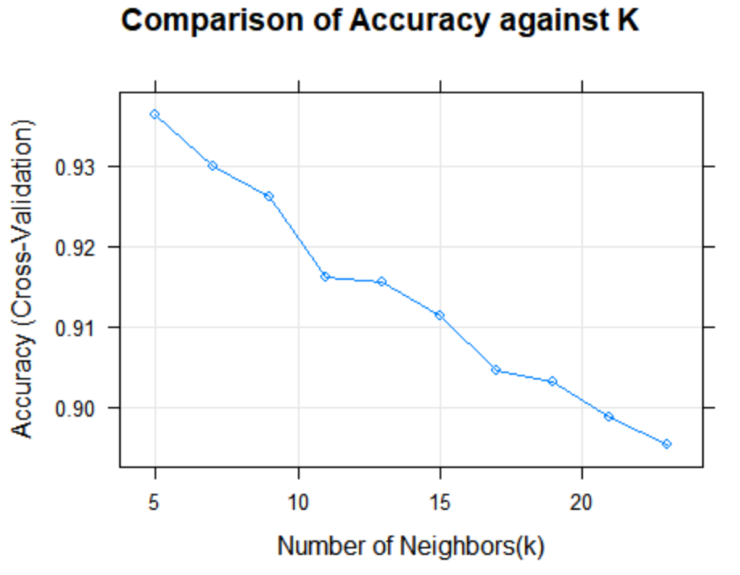

Slide 22
97.57%
Best Model Accuracy: Kth Nearest Neighbors

